Slide 1

Chapter 4 Continuous-Wave Modulation (连续波调制)
Linear modulation: 线性调制
Amplitude modulation (AM) 调幅
Double-sideband modulation (DSB) 双边带调制
Single-sideband modulation (SSB)
Vestigital-sideband modulation(VSB)

Slide 2

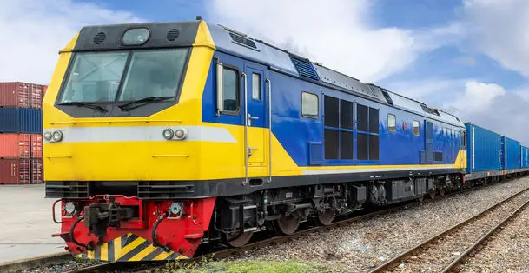

Review：回顾
Analog communication system
Modulation and demodulation？
Source of
information
Modulation
调制
Channel
Demodulation
解调
User of
information
load
unload
Noise
Goods need to be carried on different means of transport.
railway track
Wireless
Wired
Notes:
通俗解释，一定要一针见血讲透彻

Slide 3
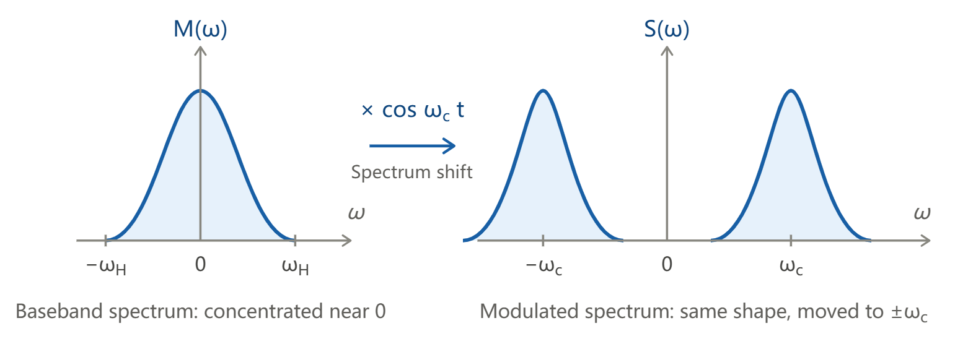
Modulation调制
Essence of Modulation 调制的本质
Modulation moves baseband information to high-frequency carrier for transmission.

Slide 4
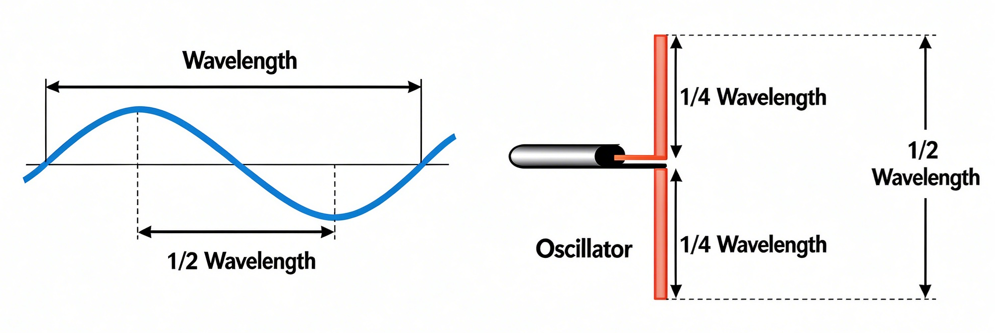
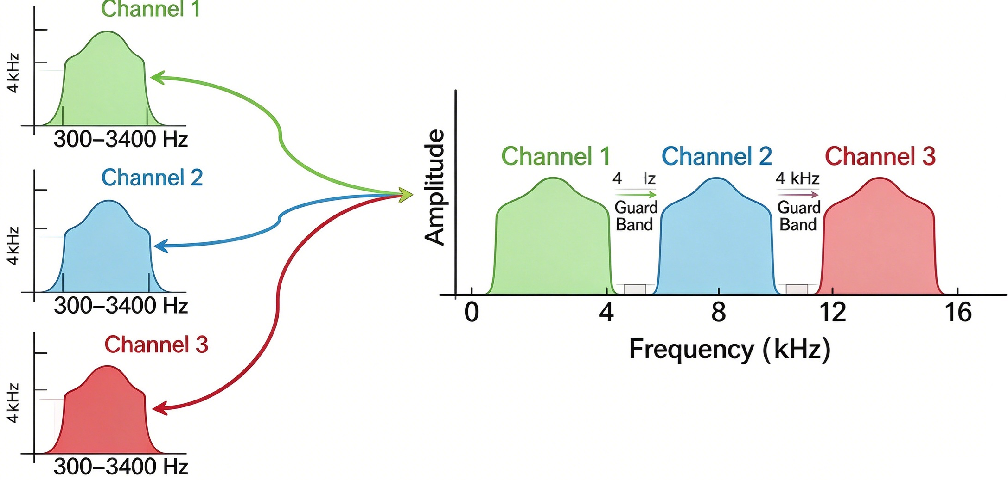
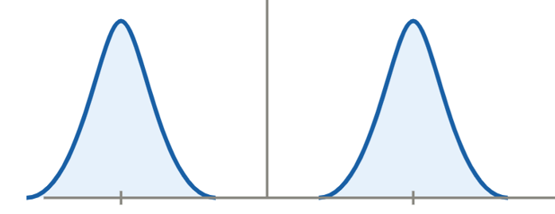
Purposes of Modulation 目的
Satisfy antenna size requirement满足天线尺寸要求
Realize frequency division multiplexing实现频分复用
Avoid low-frequency interference避开低频干扰

Slide 5
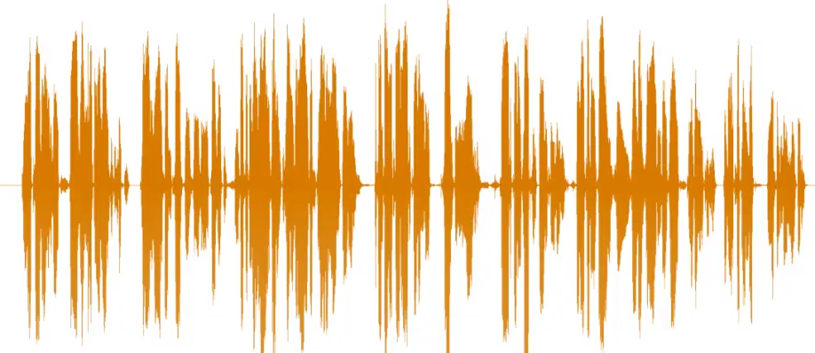
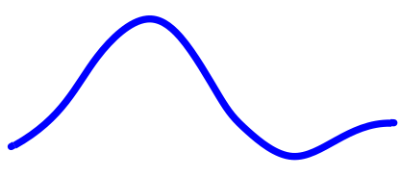
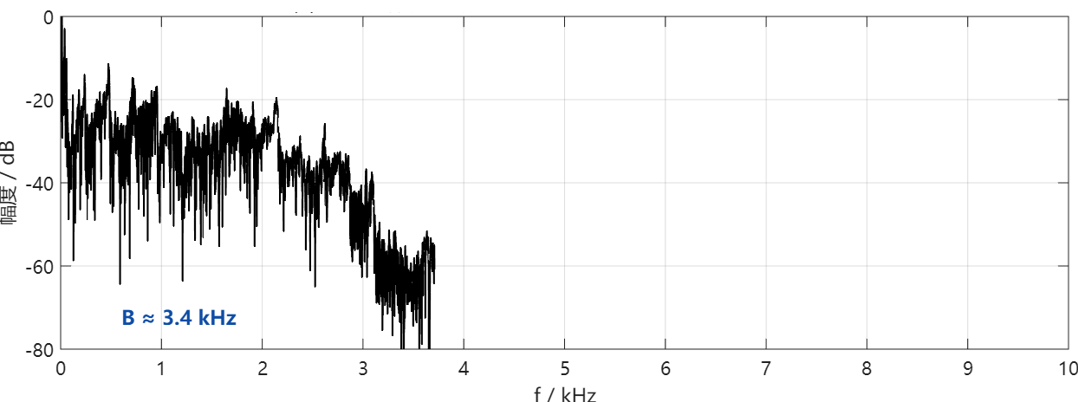

AM Communication System Project
—— 以语音信号为例
AM Communication System Project
—— 以语音信号为例
low-frequency
0 fH=3.4kHz
Speech is a low-frequency baseband signal with varying amplitude in time domain and spectrum within 200 Hz–3.4 kHz.

Slide 6
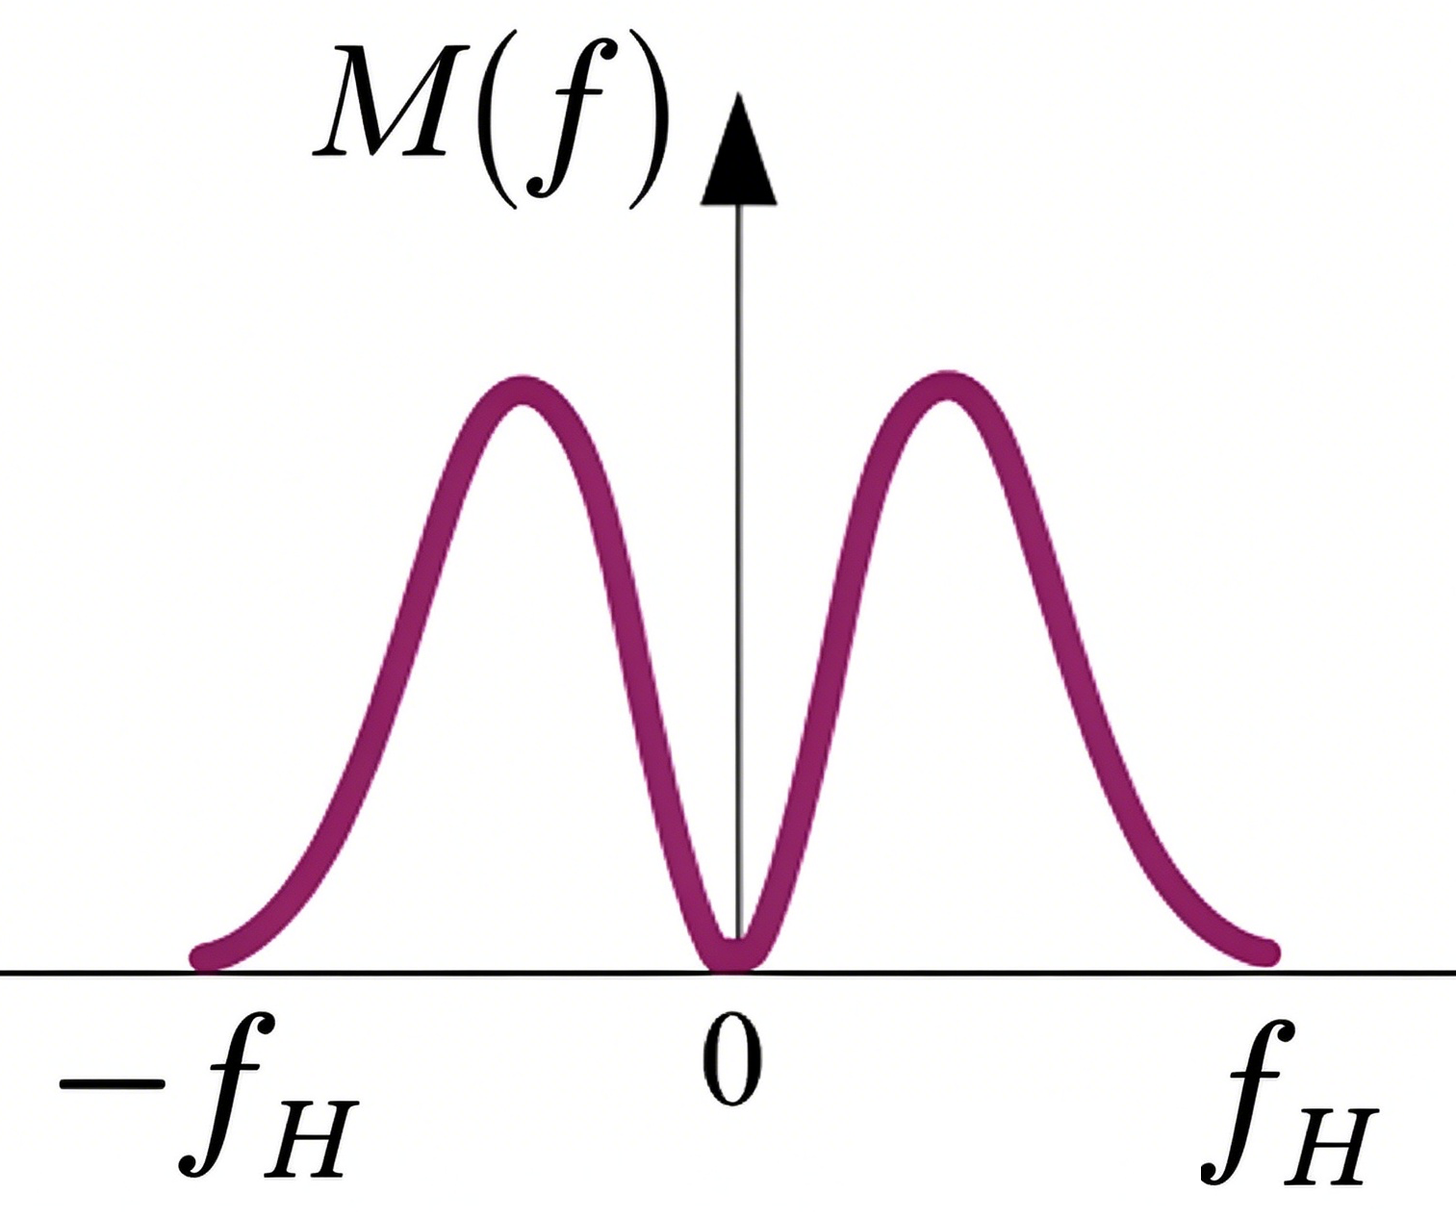
AM Communication System Project
—— 以语音信号为例
AM Communication System Project
—— 以语音信号为例
Speech is a low-frequency baseband signal with varying amplitude in time domain and spectrum within 200Hz–3.4 kHz.

Slide 7
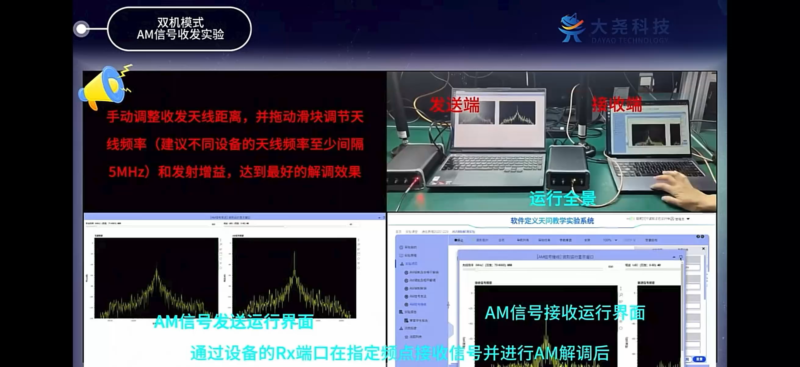
AM 通信系统实际链路——video

Slide 8
AM Communication System Project
Mathematical model: abstraction
数学模型：抽象
Time & frequency-domain characteristics
时域频域特性
Anti-noise performance 抗噪声性能
Practical AM system 实际 AM 系统

Slide 9
Mathematical model and Definition
m(t)
sm(t)
Channel
BPF
带通滤波
Envelope detector
二极管 + RC
~
+
×
m(t)
A₀
直流偏置
cosωct
carrier
n(t)
加性噪声
Modulation
m(t): baseband message signal; also called modulating signal;
the original low-frequency audio signal to be transmitted.
A₀: D.C bias 直流偏置
cosωct : carrier; high-frequency sinusoidal carrier wave;
sm(t): AM modulated signal；
the high-frequency AM signal after modulation.

Slide 10
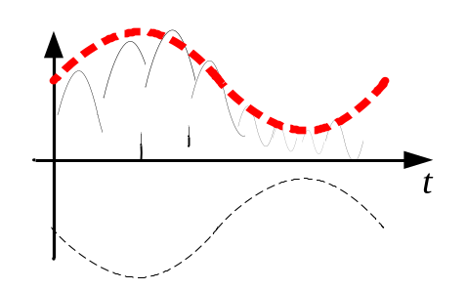
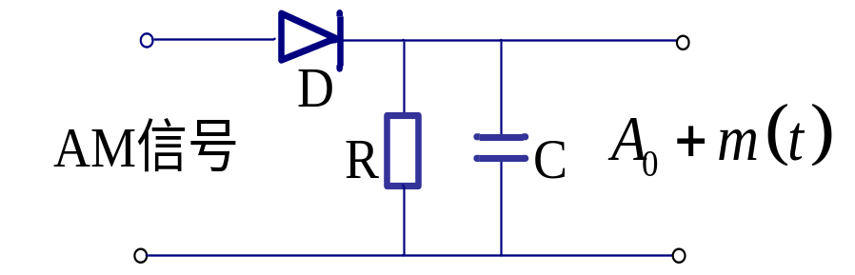
Mathematical model and Definition
m(t)
sm(t)
Channel
BPF
带通滤波
Envelope detector
二极管 + RC
~
+
×
m(t)
A₀
直流偏置
cosωct
carrier
n(t)
加性噪声
Demodulation
~
m(t): recovered baseband signal.
Demodulation

Slide 11
AM Communication System Project
Mathematical model: abstraction
数学模型：抽象
Time & frequency-domain characteristics
时域频域特性
Anti-noise performance 抗噪声性能
Practical AM system 实际 AM 系统

Slide 12
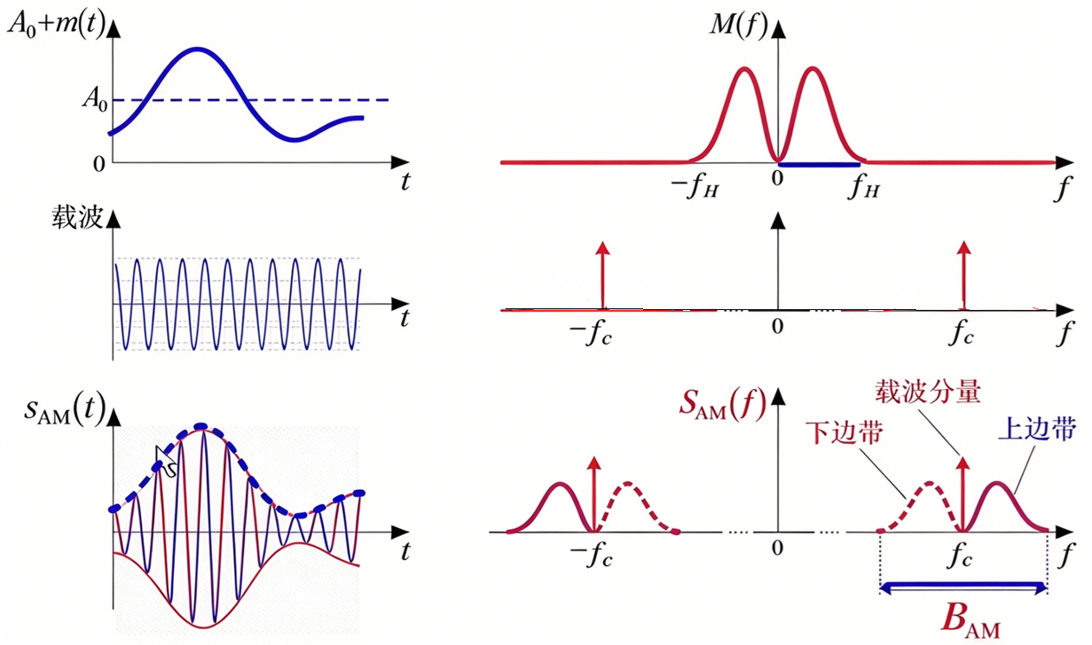
m(t)
sm(t)
Channel
BPF
带通滤波
Envelope detector
二极管 + RC
~
+
×
m(t)
A₀
cosωct
carrier
n(t)
加性噪声
Modulation
？
？

Slide 13
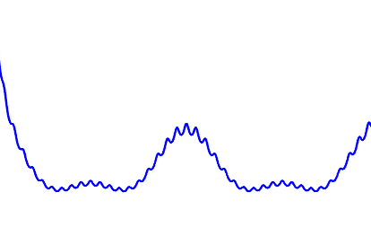

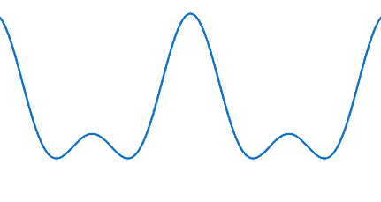
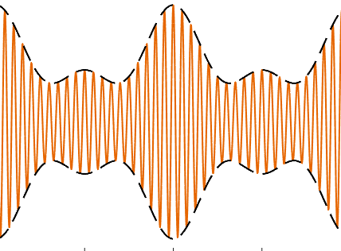
Waveform matching
problem
(a)
m(t)
cosωct
sm(t)
m(t)
(b)
(c)
~
(d)

Slide 14
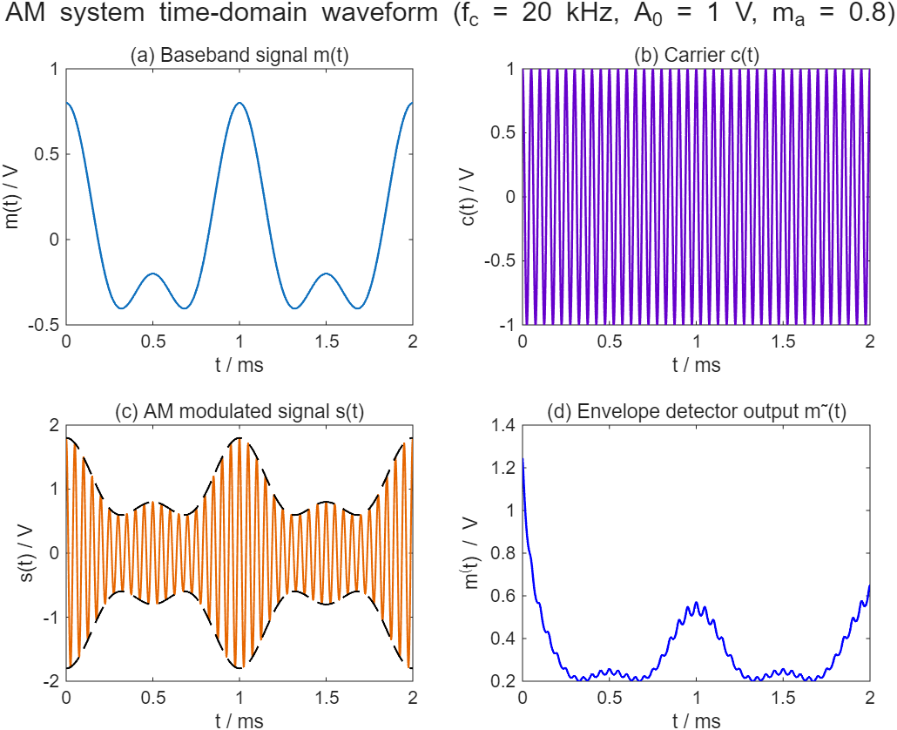

Slide 15
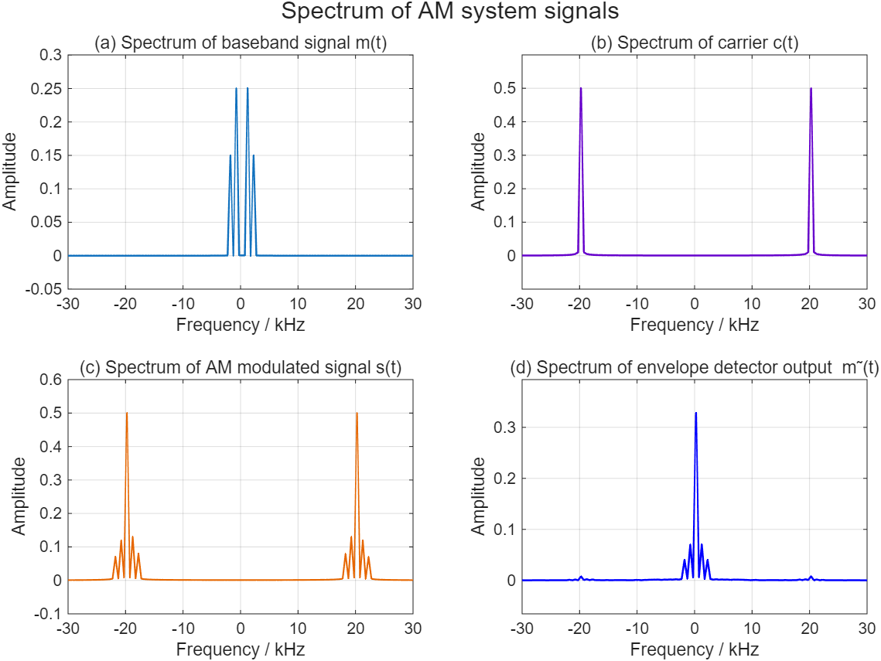
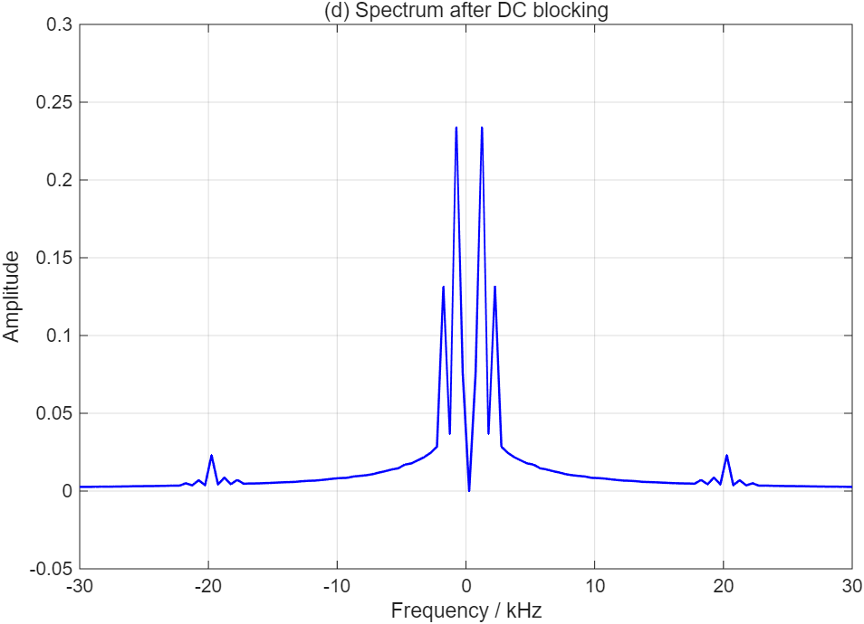

Slide 16
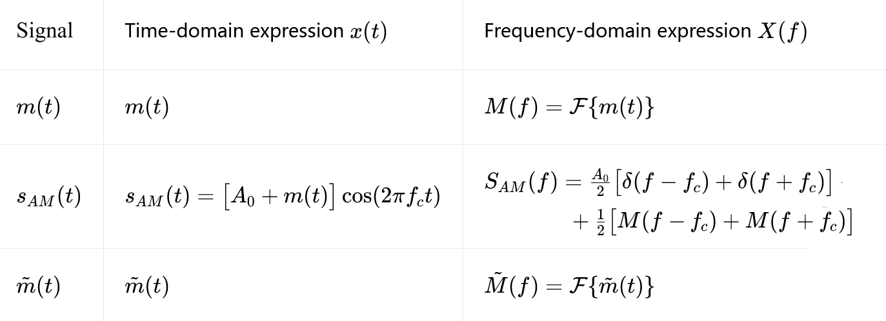
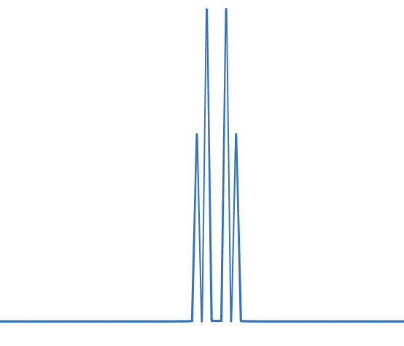
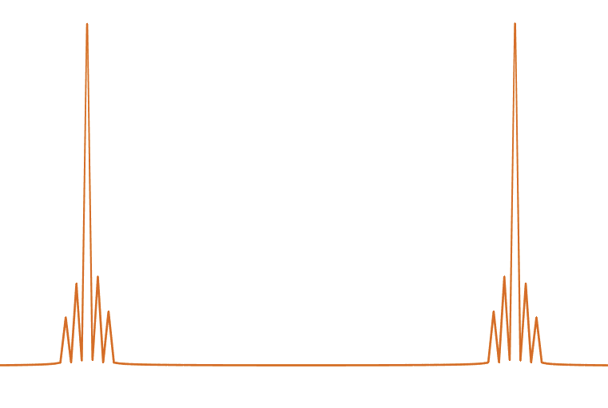
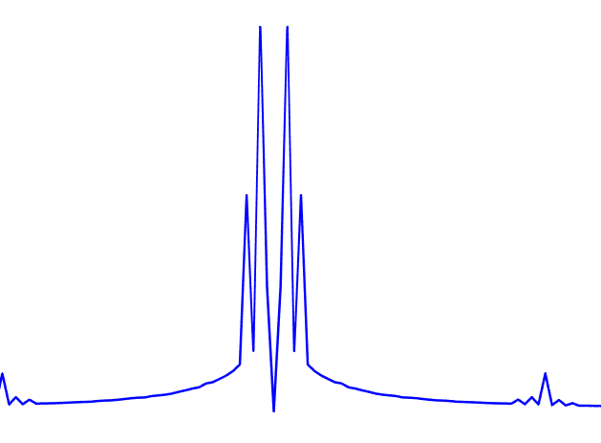
Comparison Table of Time-domain and Frequency-domain Expressions
Conclusion:
1
2
3

Slide 17
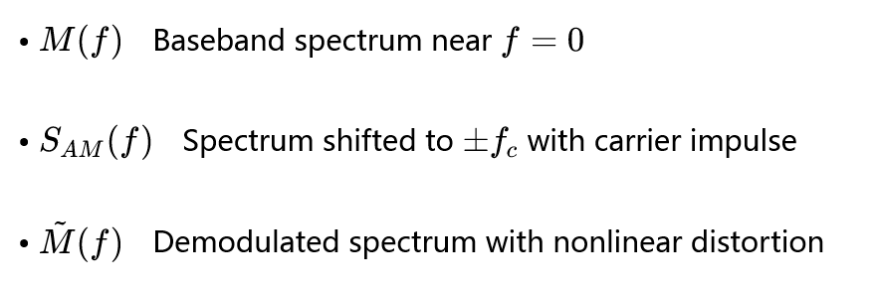

Comparison Table of Time-domain and Frequency-domain Expressions
？
？

Slide 18
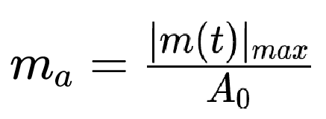
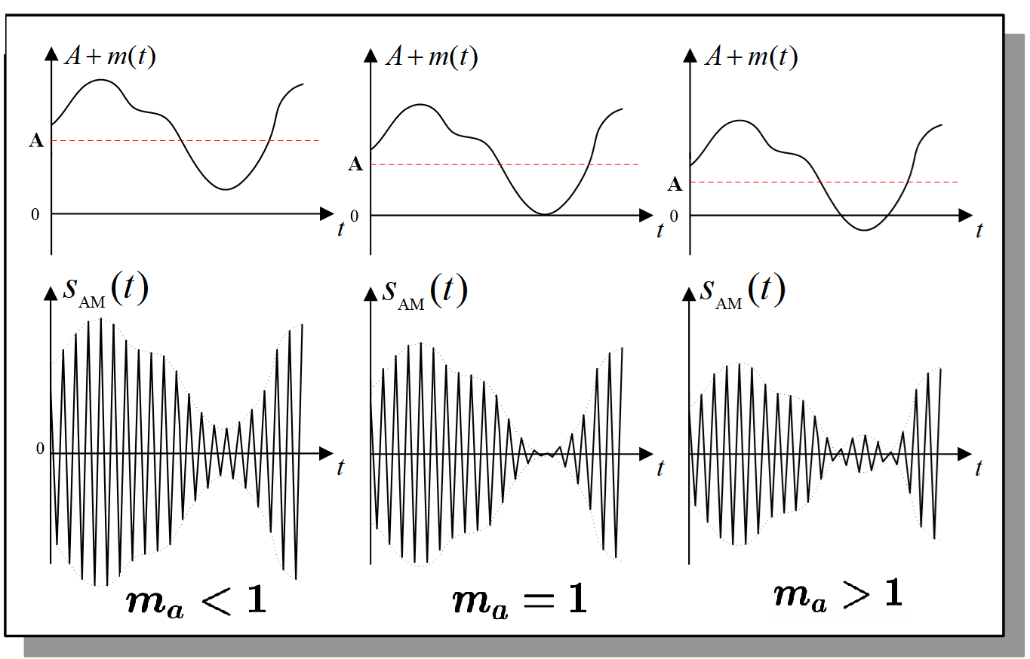
Definition of Modulation Index ma

Slide 19
满调幅
It describes how deeply the baseband signal changes the carrier amplitude.

Slide 20
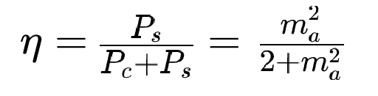
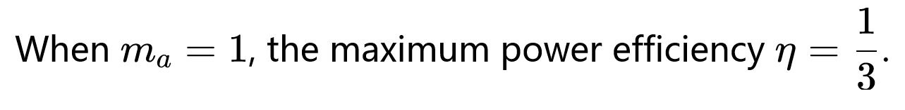
Modulation efficiency η: the ratio of useful sideband power Ps to total transmitted power P.

Slide 21
AM Communication System Project
Mathematical model: abstraction
Time & frequency-domain characteristics
Anti-noise performance 抗噪声性能
--
--
Practical AM system

Slide 22
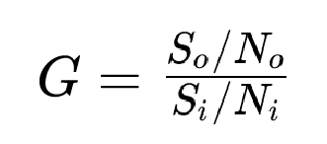
Anti-noise performance
m(t)
sm(t)
Channel
BPF
Envelope detector
~
+
×
m(t)
Si/Ni
So/No
Demodulation
A₀
cosωct
n(t)
Modulation Gain 调制制度增益: An indicator for analog modulation systems to evaluate anti-noise performance of the demodulator.

Slide 23
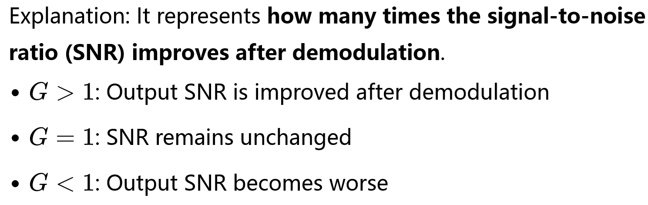
Anti-noise performance
m(t)
sm(t)
Channel
BPF
Envelope detector
~
+
×
m(t)
Si/Ni
So/No
A₀
cosωct
n(t)
Demodulation
Modulation Gain 调制制度增益: An indicator for analog modulation systems to evaluate anti-noise performance of the demodulator.

Slide 24
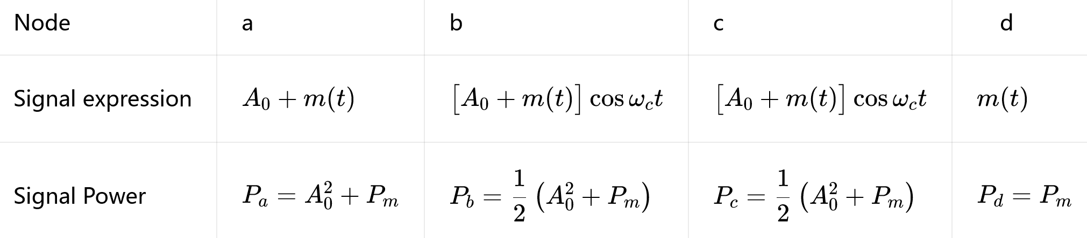
Anti-noise performance——Large SNR
m(t)
sm(t)
Channel
BPF
Envelope detector
~
+
×
m(t)
a
b
c
d
A₀
cosωct
n(t)
Signal Power
？

Slide 25
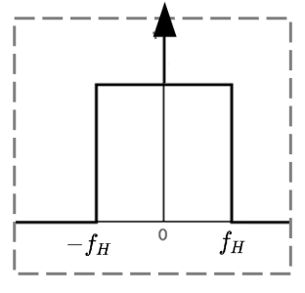



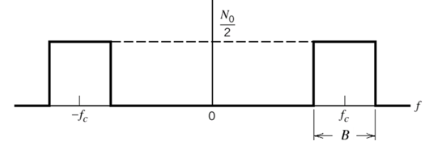




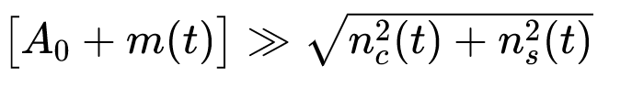

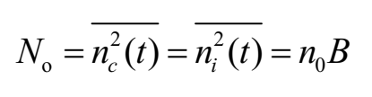
Anti-noise performance——Large SNR
m(t)
sm(t)
Channel
BPF
Envelope detector
~
+
×
m(t)
A₀
cosωct
n(t)
Large SNR：

Slide 26

Anti-noise performance——Large SNR
m(t)
sm(t)
Channel
BPF
Envelope detector
~
+
×
m(t)
A₀
cosωct
n(t)

Slide 27
Anti-noise performance——Large SNR
m(t)
sm(t)
Channel
BPF
Envelope detector
~
+
×
m(t)
A₀
cosωct
n(t)

Slide 28
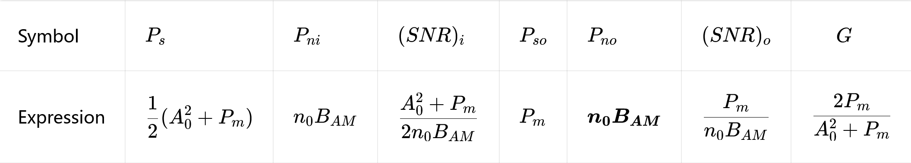
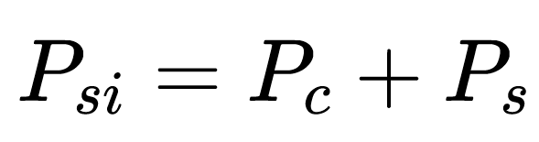

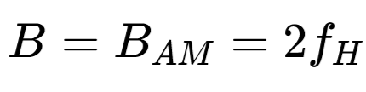
Anti-noise performance——Large SNR
m(t)
sm(t)
Channel
BPF
Envelope detector
~
+
×
m(t)
A₀
cosωct
n(t)
？
？
Envelope detection removes the 1/2 power attenuation introduced by the high-frequency carrier.
注：

Slide 29
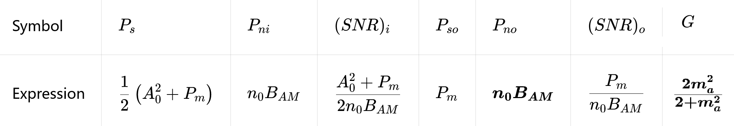
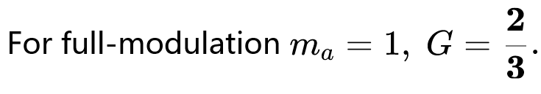
Anti-noise performance——Large SNR
m(t)
sm(t)
Channel
BPF
Envelope detector
~
+
×
m(t)
A₀
cosωct
n(t)
Special case: m(t) is a single‑tone sinusoidal signal. 单音正弦信号
？
？
Since G<1, AM envelope detection provides no SNR gain and exhibits poor noise performance.

Slide 30

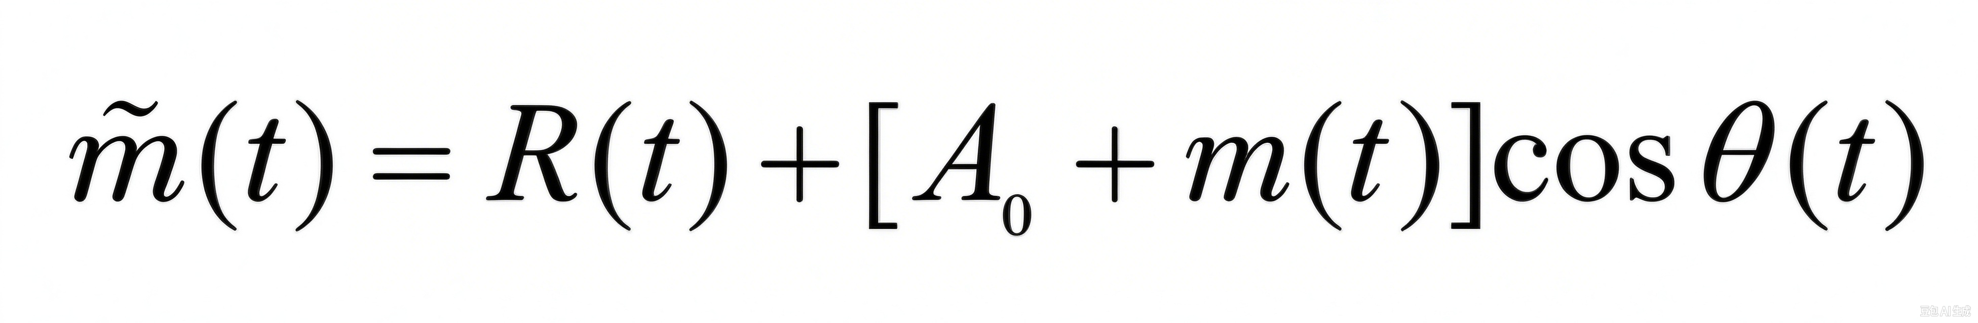
Anti-noise performance——Small SNR
Small SNR:
m(t)
sm(t)
Channel
BPF
Envelope detector
~
+
×
m(t)
Demodulation
A₀
cosωct
n(t)
The signal is
corrupted扰乱 by noise.

Slide 31
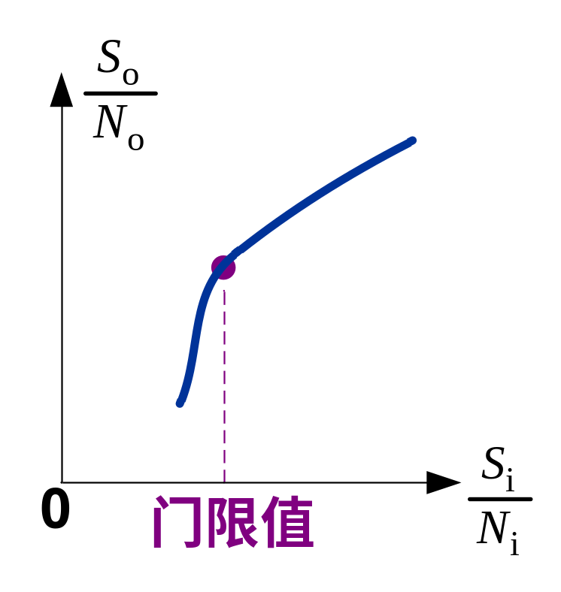

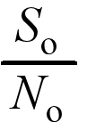
Anti-noise performance——Small SNR
Small SNR:
Envelope detector
Threshold effect:
If the input signal‑to‑noise ratio drops below a specific threshold, the output signal‑to‑noise ratio deteriorates much faster than the input SNR.
Nonlinear detector(envelope detector) has a threshold effect.

Slide 32

Anti-noise performance——Small SNR video

Slide 33
AM Communication System Project
Mathematical model: abstraction
数学模型：抽象
Time & frequency-domain characteristics
时域频域特性
Anti-noise performance 抗噪声性能
Practical AM system 实际 AM 系统

Slide 34
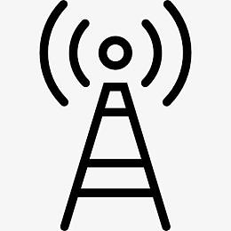
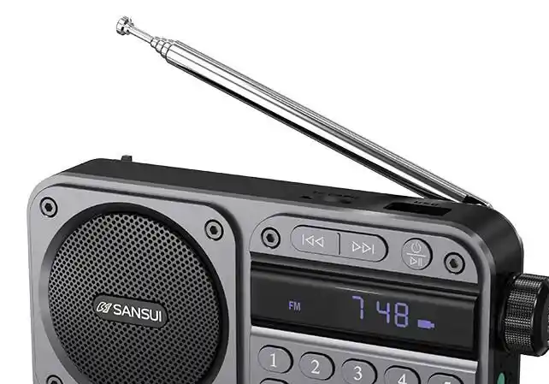
A Real AM Communication System
Transmitter
Microphone
m(t)
m(t)
Band-limiting
0.3–3.4 kHz
m(t)
AM modulator
[Ac+m(t)]·cosωct
s(t)
Band-pass filter
BPF · fc±B
s(t)
Power amplifier
Class C → antenna
modulated RF
Channel
AWGN + attenuation
r(t)=s(t)+n(t)
Receiver
Loudspeaker
Recover m(t)
m(t)
Audio amplifier
AF gain
m(t)
DC blocking
Remove Ac
envelope
Envelope det.
Diode + RC
r(t)
RF amplifier
+ BPF
vs DSB-SC: no carrier-recovery circuit needed
No local carrier
No carrier sync
Chain: mic → AM mod → PA → channel → RF amp → envelope det. → DC block → audio amp → speaker
Envelope detection needs no local carrier — that is why AM receivers stay simple and cheap.
Trade-off: AM wastes about two thirds of transmitter power on the carrier (max efficiency 33%).
Communication Principles · Amplitude Modulation (AM)

Slide 35
AM 通信系统实际链路
通信原理 · 模拟幅度调制
发射机 Transmitter
信源话筒
m(t)
m(t)
限带滤波
0.3–3.4 kHz
m(t)
AM 调制器
[Ac+m(t)]·cosωct
s(t)
带通滤波
BPF · fc±B
s(t)
功率放大
C 类 → 天线
已调信号
信道 Channel
AWGN + 衰减
r(t)=s(t)+n(t)
接收机 Receiver
扬声器
恢复 m(t)
m(t)
音频功放
低频放大
m(t)
隔直耦合
去掉 Ac
包络
包络检波
二极管 + RC
r(t)
高频放大
+ BPF
对比 DSB-SC：省去载波同步电路
本地载波：不需要
无需载波同步
全链路：话筒 → 限带 → AM 调制 → 功放 → 信道 → 高放 → 包络检波 → 隔直 → 音频功放 → 扬声器
包络检波不需要本地载波 —— 这正是 AM 接收机简单、便宜的原因
代价：AM 把约三分之二的发射功率浪费在载波上（最高效率 33%），换来这份简单
通信原理 · 幅度调制（AM）
1 / 2

Slide 36
AM 通信系统实际链路——video

Slide 37
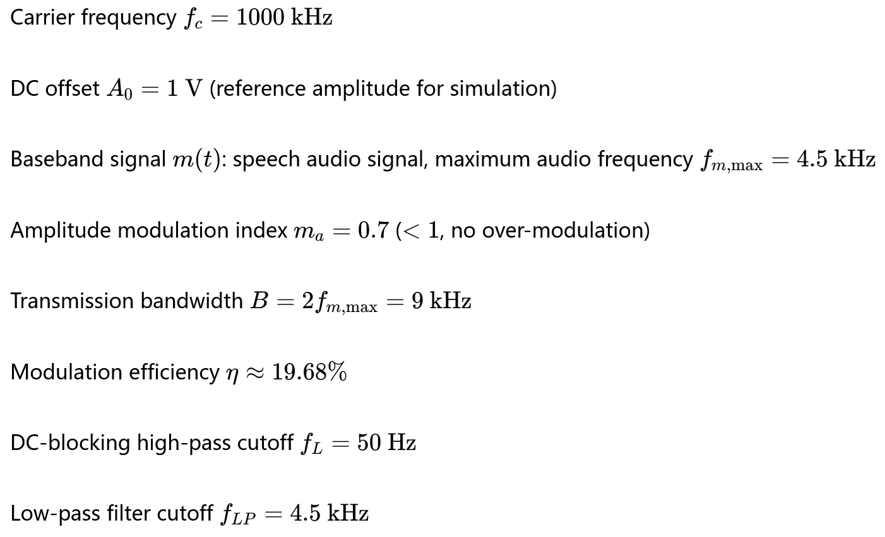
Commercial Medium-wave AM Broadcasting System Parameters

Slide 38
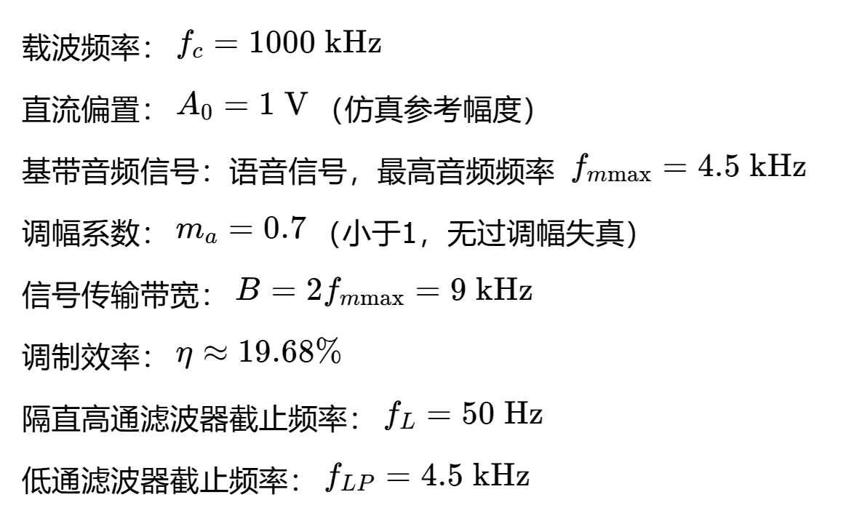
商用中波 AM 广播系统参数

Slide 39
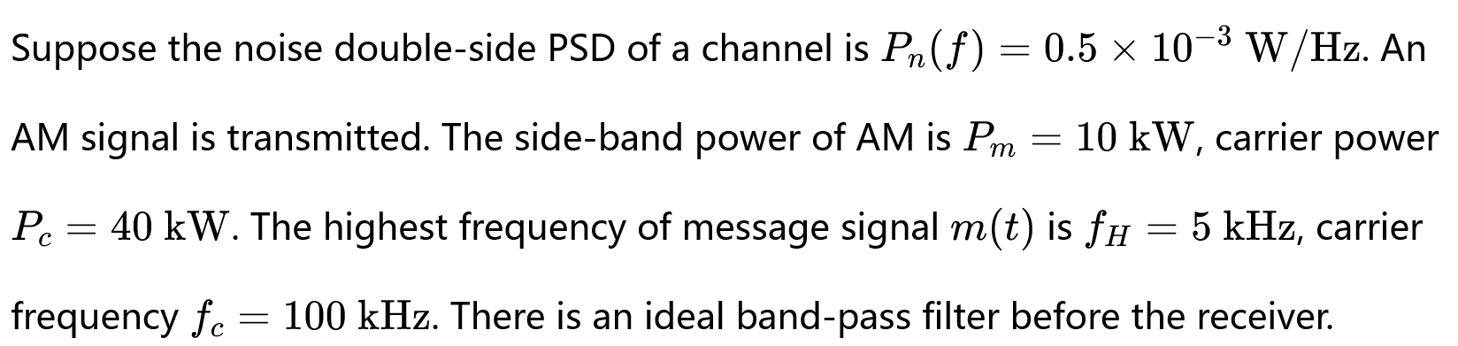
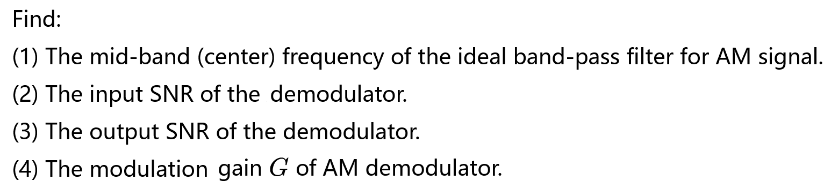
Example

Slide 40
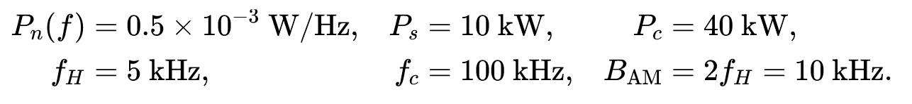
Known Conditions

